Slide 1
Using Ontology to Represent Data
William Duncan

Slide 2
Themes
Data integration issues
Data as a graph
Leveraging semantics
Triplestores and SPARQL
Data Specifications
Data wrangling

Slide 3


Data Integration Issues
Different fields and values
← Patients 1 table
Patients 2 table →

Slide 4
Data Integration Issues
Ambiguity:
Does ‘sex’ mean gender or biological sex?

Slide 5

Data Integration Issues
Structural complexity

Slide 6
Data Integration Issues
Other important issues
Schema type (normalized vs. non-normalized)
Indexing
Federation across multiple database
Flavors of SQL
Provenance

Slide 7
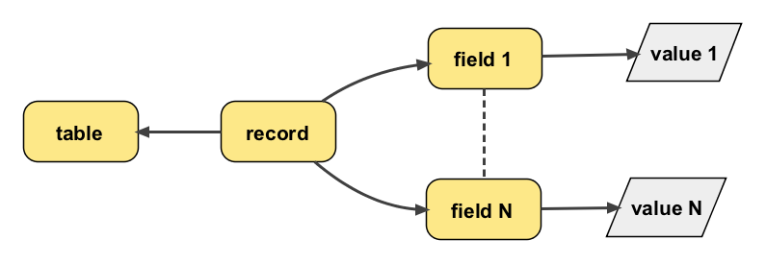
Data as Graph

Slide 8

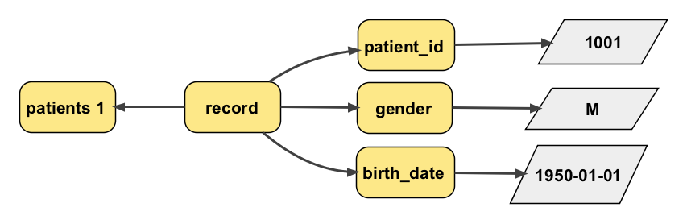
Data as Graph

Slide 9

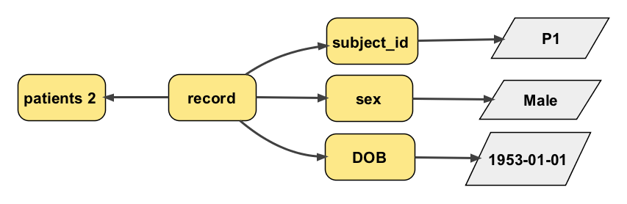
Data as Graph

Slide 10
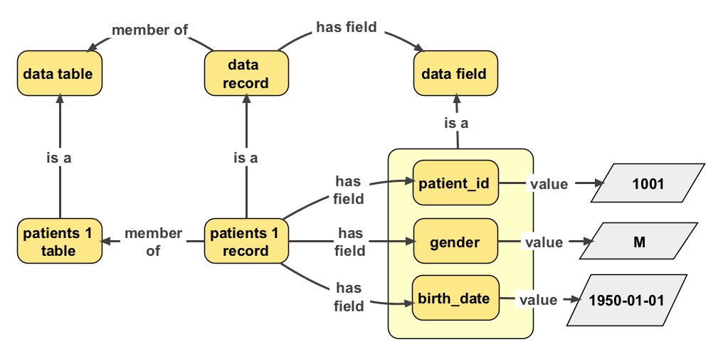
Data as Graph - Semantics

Slide 11
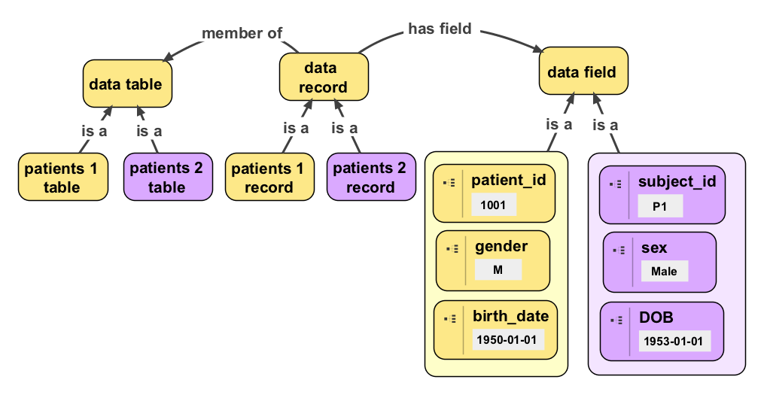
Data as Graph - Semantics

Slide 12


Data as Graph - Semantics
Sex fields with value “Male” represent male genders
Gender fields with value “M” represent male genders

Slide 13


Data as Graph - Semantics

Slide 14
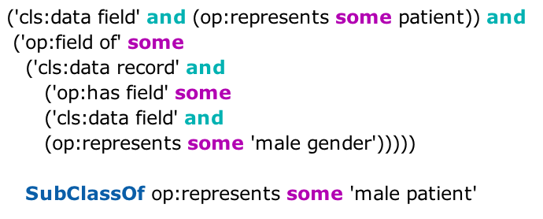
Data as Graph - Semantics
Fields that represent patients and
Are members of records that have a field which represents male genders
Represent male patients

Slide 15
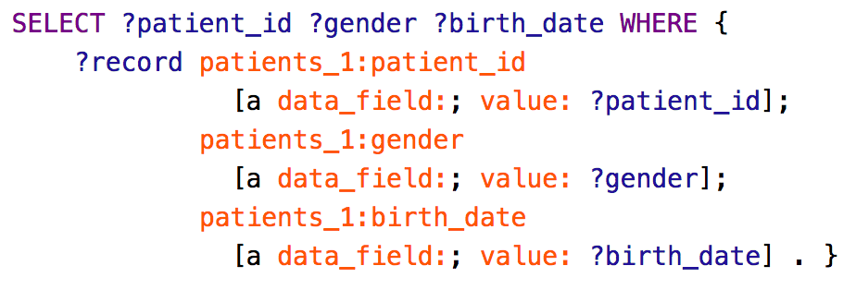
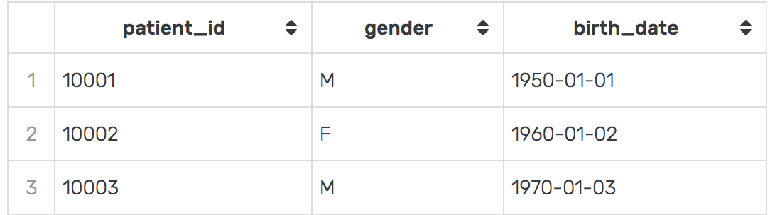
Data as Graph - SPARQL
Queries can have an SQL feel

Slide 16
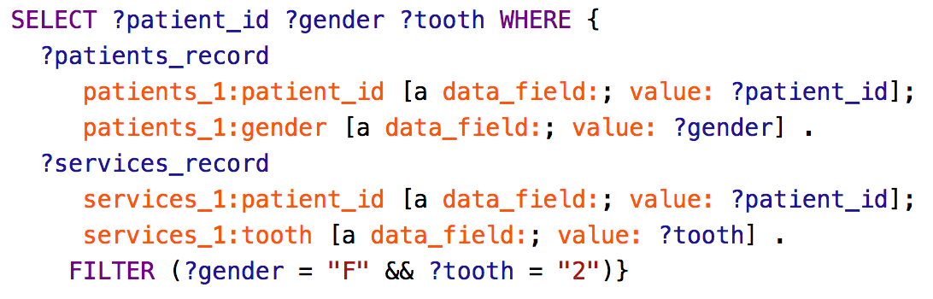
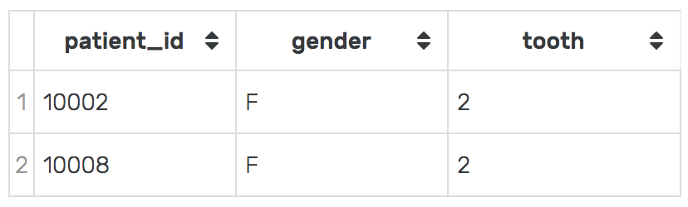
Data as Graph - SPARQL
Join across patients_1 and services_1 tables

Slide 17
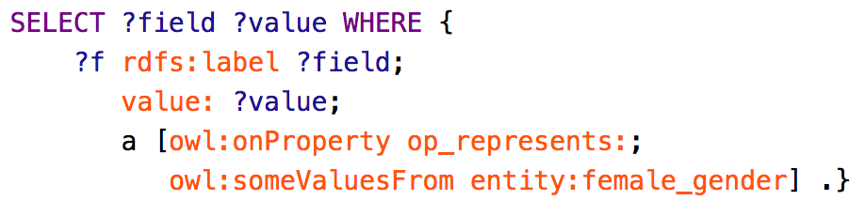
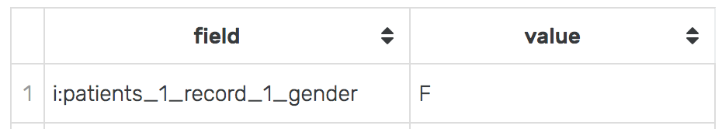

Data as Graph - SPARQL
Find all fields that represent female genders

Slide 18
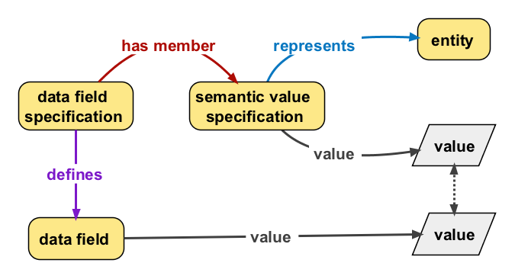
Data Specifications

Slide 19
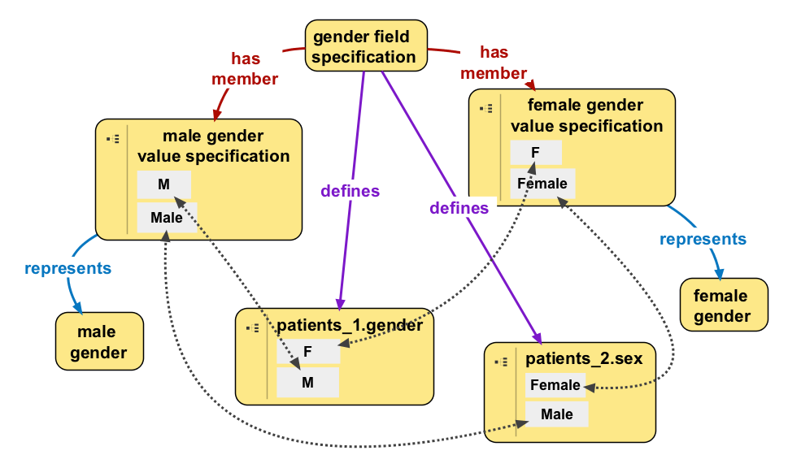
Data Specifications

Slide 20
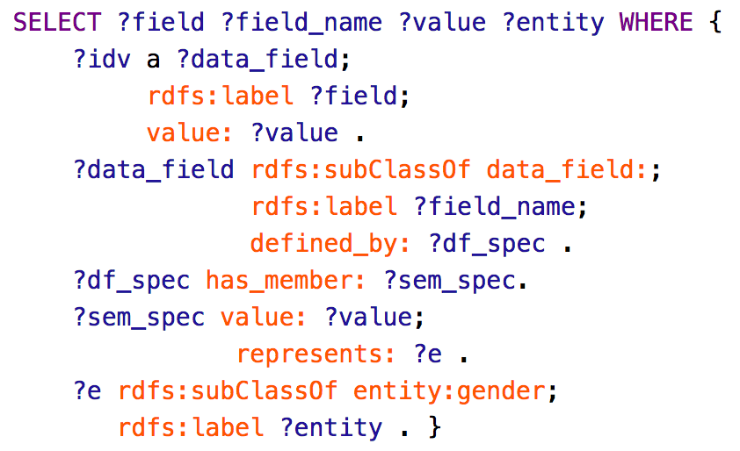
Data Specifications - SPARQL
Find all fields that match data specifications with semantic value that represents genders

Slide 21
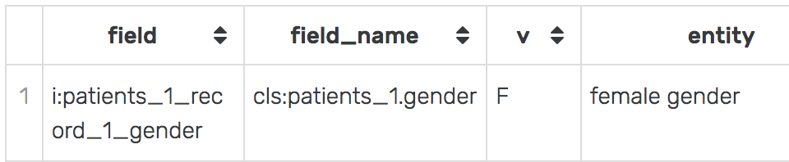
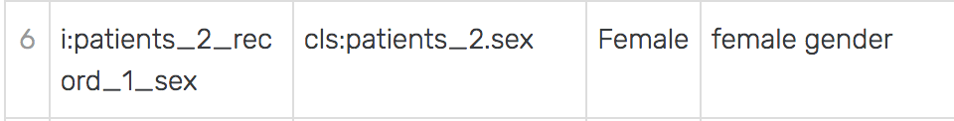
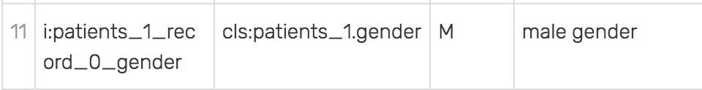
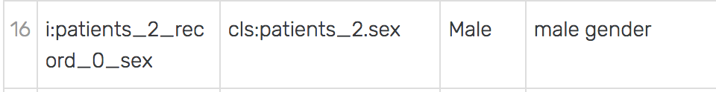
Data Specifications - SPARQL

Slide 22
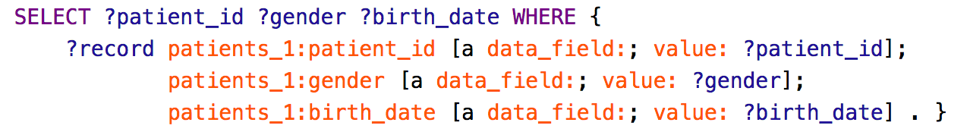
SPARQL – Data Wrangling
Return records in tabular structure

Slide 23
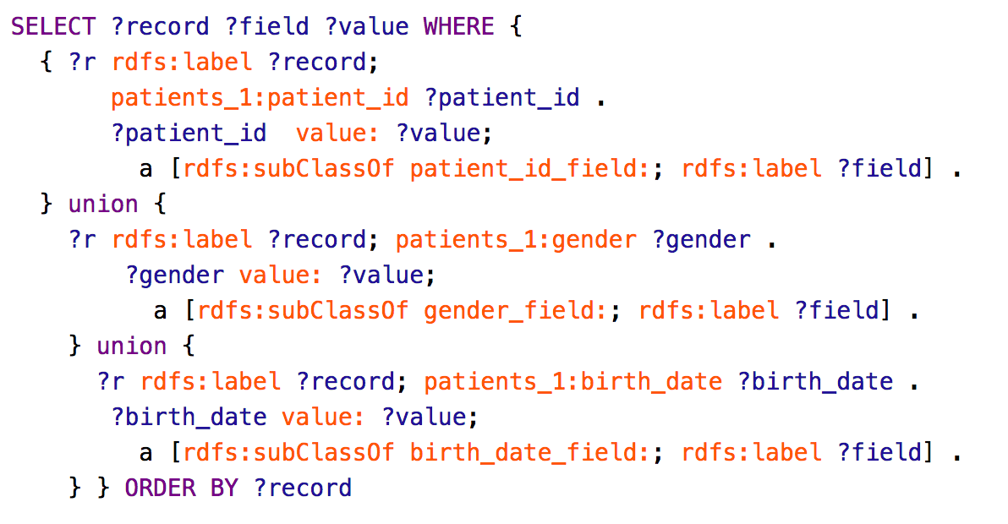
SPARQL – Data Wrangling
Return records in EAV structure

Slide 24
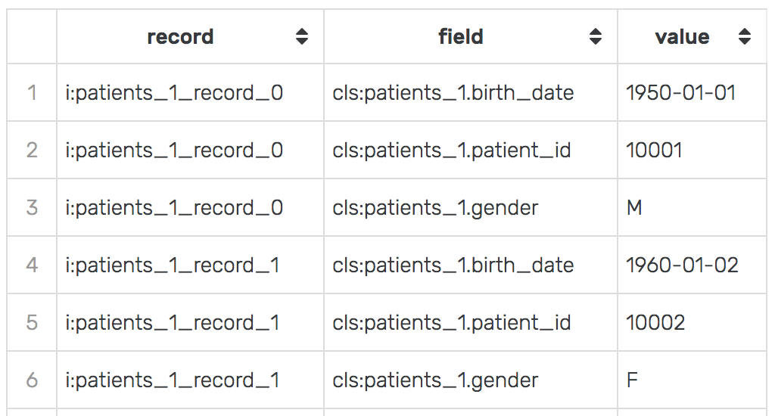
SPARQL – Data Wrangling

Slide 25
FAIR Data
Data is
Findable
Accessible
Interoperable
Reusable
https://www.ncbi.nlm.nih.gov/pmc/articles/PMC4792175/

Slide 26
FAIR Data - Findable
F1. (Meta)data are assigned a globally unique and persistent identifier
F2. data are described with rich metadata
With an ontology
Each individual table, field, record has a unique identifier
Each class and property has a unique identifier

Slide 27
FAIR Data - Findable
F3. Metadata clearly and explicitly include the identifier of the data it describes
F4. (Meta)data are registered or indexed in a searchable resource
With ontology
Individuals are inherently linked to class
Metadata can be queried

Slide 28
FAIR Data - Accessible
A1. (Meta)data are retrievable by their identifier using a standardized communications protocol
A1.1 the protocol is open, free, and universally implementable
With ontology
Ontologies are developed against the background of the Semantic Web. Accessibility is “baked in”.

Slide 29
FAIR Data - Interoperable
I1. (Meta)data use a formal, accessible, shared, and broadly applicable language for knowledge representation.
With ontology
Ontologies are developed using W3 Standards such as OWL, RDF, SPARQL

Slide 30
FAIR Data - Interoperable
I2. (Meta)data use vocabularies that follow FAIR principles
I3. (Meta)data include qualified references to other (meta)data
With ontology
Ontologies can easily import other ontologies that follow FAIR principles
Imported ontologies can be easily reused

Slide 31
FAIR Data - Reusable
R1. (Meta)data are richly described with a plurality of accurate and relevant attributes
R1.1. (Meta)data are released with a clear and accessible data usage license
With ontology
Entities are easily linked together and annotated using properties
Licenses can be assigned to an ontology (e.g., BFO specifies creative commons 4.0)

Slide 32
FAIR Data - Reusable
R1.2. (Meta)data are associated with detailed provenance
R1.3. (Meta)data meet domain-relevant community standards
With ontology
Annotations allow you to easily add who, when, or whey an entity was created. Can be linked to provenance standards, such as the PROV Ontology.
Developed using shared principles (e.g., OBO Foundry, SNOMED).

Slide 33
Thanks for listening!
Questions/Comments?

